Slide 1
Classification of Time-Series Images Using Deep Convolutional Neural Networks
Nima Hatami, Yann Gavet, Johan Debayle

Slide 2
Convolutional Neural Networks (CNN) has achieved a great success in image recognition task by automatically learning a hierarchical feature representation from raw data.
While the majority of Time-Series Classification (TSC) literature is focused on 1D signals, this paper uses Recurrence Plots (RP) to transform time-series into 2D texture images and then take advantage of the deep CNN classifier.

Slide 3
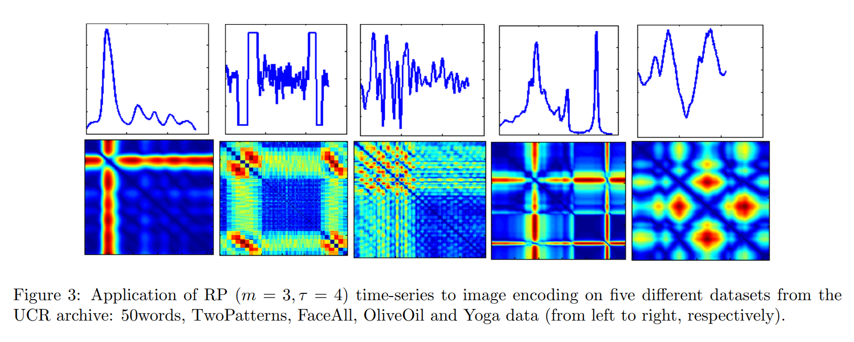
RP(Recurrence Plots)

Slide 4
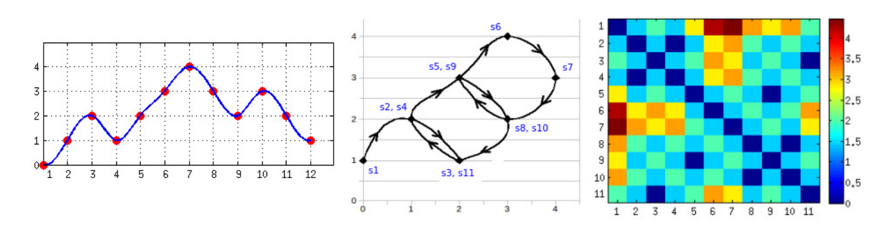
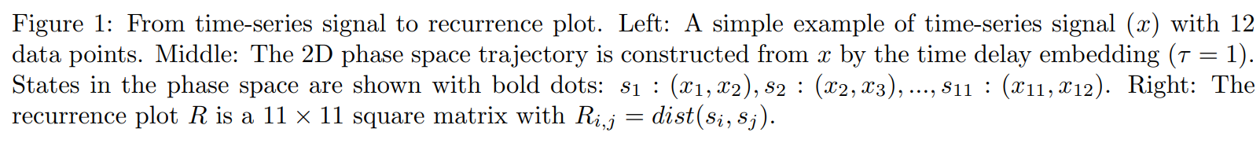
RP(Recurrence Plots)

Slide 5
RP provides a way to visualize the periodic nature of a trajectory through a phase space and enables us to investigate certain aspects of the m-dimensional phase space trajectory through a 2D representation.
RP알고리즘을 이용하여 시계열 데이터를 이미지로 변환하는 과정은 두 단계
Step1. 시계열 데이터의 m차원 공간 궤적 구성
Step2. m차원 공간 궤적을 RP행렬로 표현

Slide 6
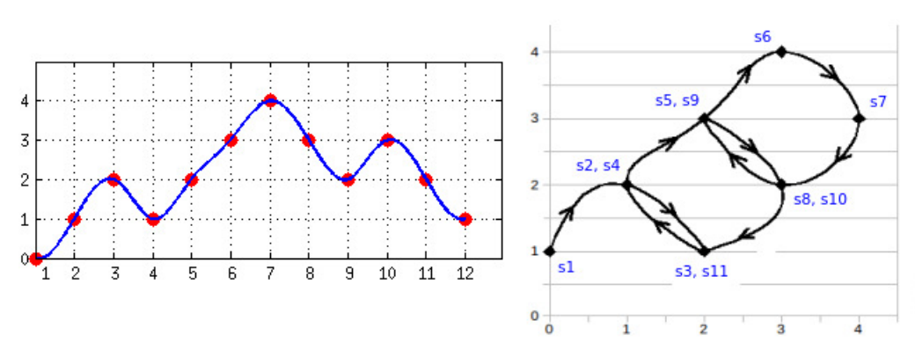
Step 1
M = 2

Slide 7
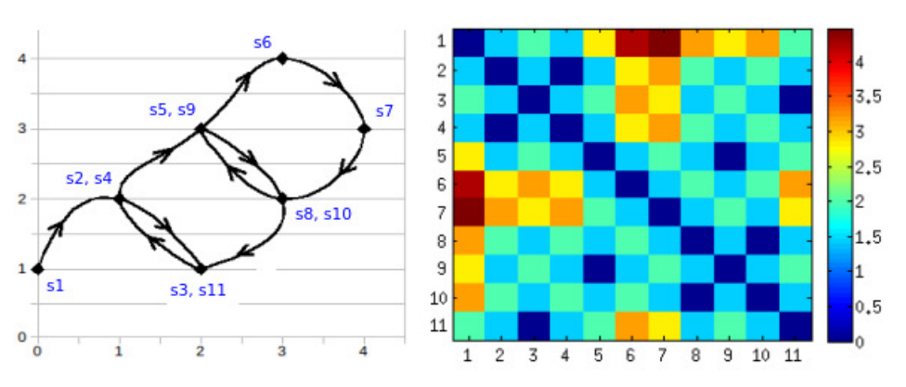
Step 2

Slide 8
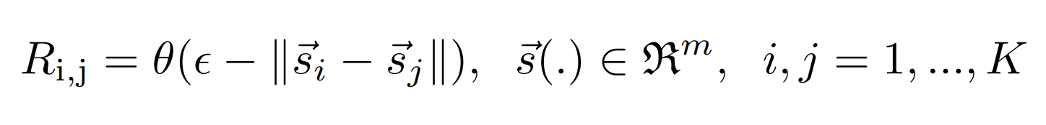
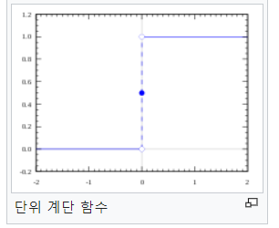
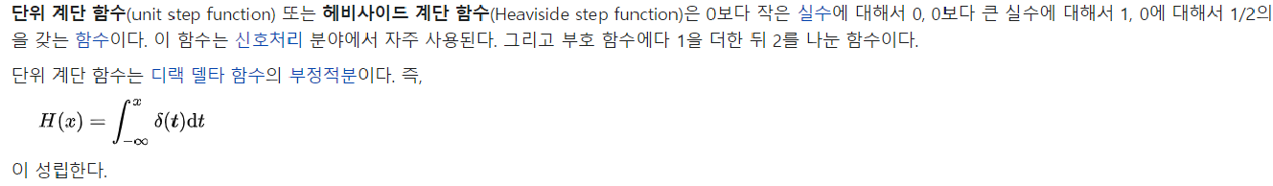
θ(x) : 단위 계단 함수 Heaviside function.
쉽게 말해, R(i,j)는 S(i) 와 S(j)의 거리. 다만 거리에 약간의 최소기준치(e)와 반올림을 취했을 뿐

Slide 9
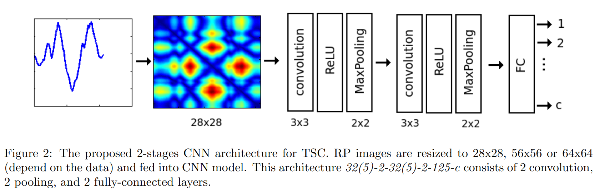

Slide 10
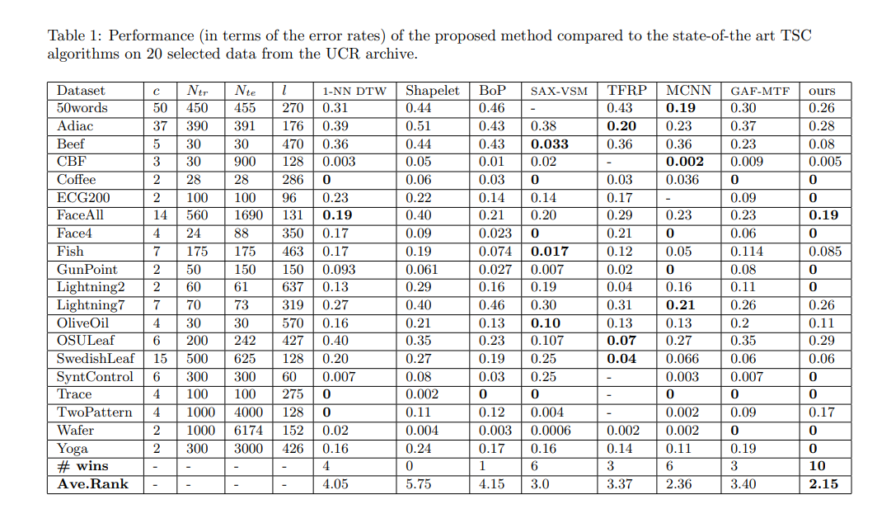

Slide 11
CONCLUSIONS
This pipeline offers the following advantages:
RP enables us to visualize certain aspects of the m-dimensional phase space trajectory through a 2D images
CNN automatically learns different levels of time-series features and classification jointly and in a supervised manner.

Slide 12
감사합니다.

